Slide 1
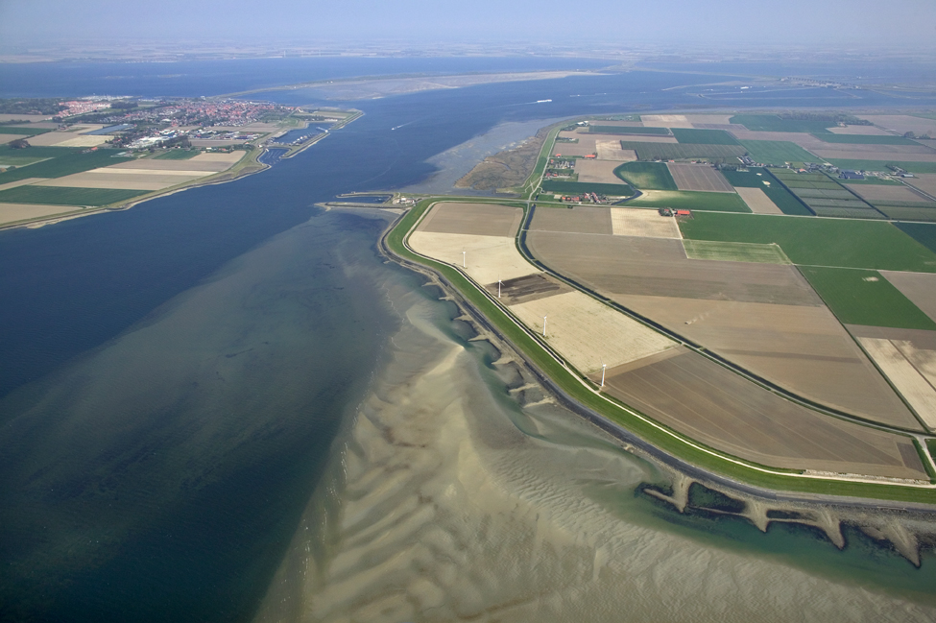


FEWS Static Configuration

Slide 2
FEWS Static Configuration Data
Location data
Locations
Location Sets
Location Icons
Parameters
Parameters
Time Series Display Configuration
Parameter Unit Conversions
Maps and FewsExplorer
OpenMap properties
Grid Display
FEWS Explorer
Other Static Configurations
Grids
Branches

Slide 3
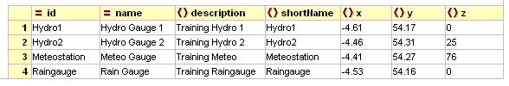
Locations
Information for each location in the FEWS Config

Slide 4
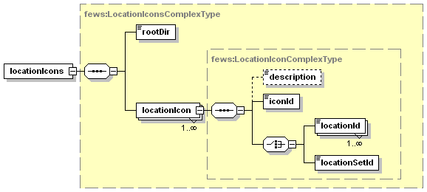
Location Icons
Location Icons are used to help identify types of locations
catchment site
coastal
fluvial site
meteo site
radar site
Notes:
Also a good example of why locationsets are useful

Slide 5
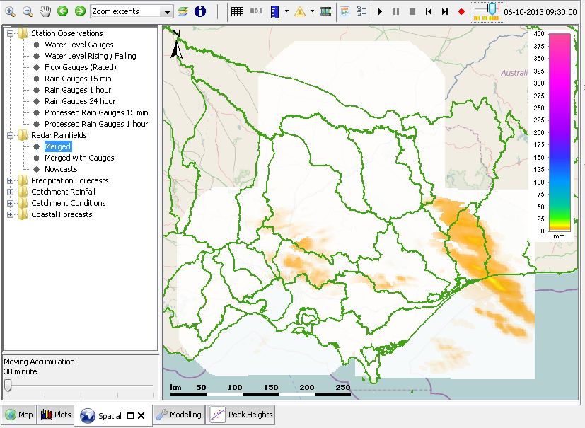
Grids are locations to FEWS
Grid time series are two dimensional time series
A grid location is required in the locations XML file
The Grids configuration file includes mete-information of a grid
The spatial display can show gridded timeseries

Slide 6
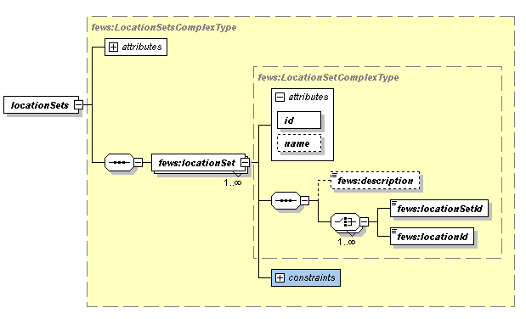

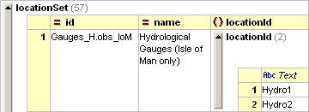
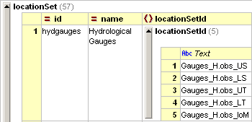
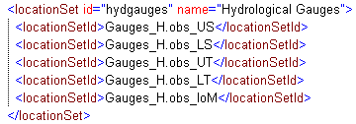
LocationSets
LocationSets define groups of locations
LocationSets can be nested!

Slide 7
LocationSets - the meta data approach
XML was the basis for FEWS for many years ...but
Location meta data often managed in other systems (e.g. GIS)
Location coordinates in shape (.shp), associated attributes in tabular form (.dbf)
Introduced to FEWS in 2007/2008
Since 2013 also in .csv files
easier to maintain locations
Location attributes can be used to:
compose location sets with similar characteristics
define idmaps (translation tables for importing/export data)
define threshold crossing values
define range values for validation rules
define coefficients for calculations
Notes:
7

Slide 8

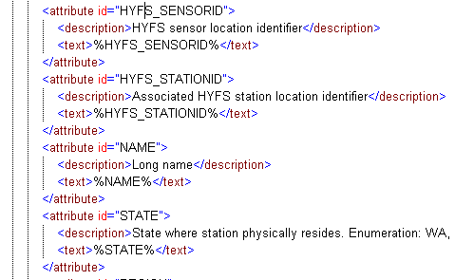
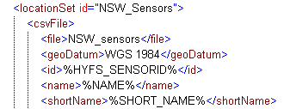
Xml and CSV – the meta data approach
3 step definition
The CSV file defines per location (row) the value for a specific attribute (by column)
LocationSets.xml file tells FEWS how to read the CSV file by allocating ‘%column_name%’ to location attribute
Other configuration files apply these attribute values for various purposes Replace ‘@attribute-name@’ with attribute value
Values example from: NSW_sensors.csv
Notes:
8

Slide 9
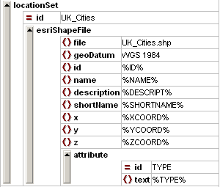
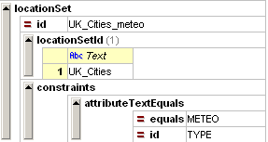

Composing locationSets with location attributes
LocationSets can be generated from another locationSet by using attributes and conditions:
attribute equals
attribute contains
attribute starts with
id contains
attribute exists
…
Notes:
Also a good example of why locationsets are useful

Slide 10
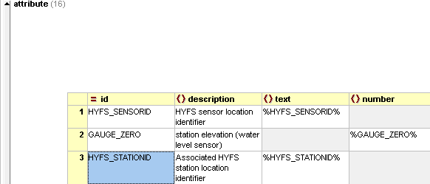
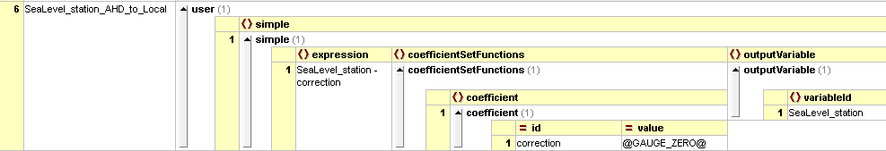
Calculation coefficients via location attributes
Example from: LocationSets_NSW.xml
Definition is part of locationSet NSW_sensors
Define attributes for Gauge datum correction
Allocate attribute values per sensor
Apply attribute value in calculation
Example from: NSW_sensors.csv
Example from: Process_Surge.xml
Notes:
10

Slide 11
Xml and CSV recap
XML and CSV 3 step definition
The CSV file defines per location (row) the value for a specific attribute (by column)
LocationSets.xml file tells FEWS how to read the CSV file by allocating ‘%column_name%’ to location attribute
Other configuration files apply these attribute values using ‘@attribute-name@’ for various purposes
→ Configuration extension and maintenance shifts to meta data
Delft-FEWS Configuration Course
September 2013
11
Notes:
11

Slide 12
Exercise
Exercise 2: Locations and LocationSets

Slide 13
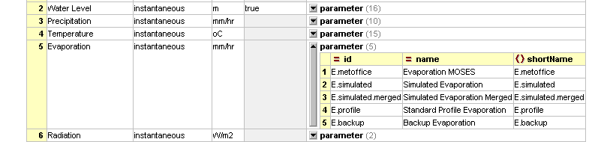
Parameters
Parameters are organised into parameter groups with a unique id and name
Parameters have a unique id and a name
The parameter is a primary key in the time series

Slide 14
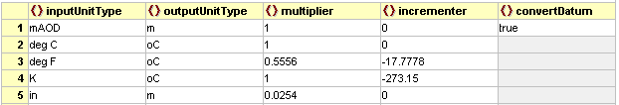
Parameters – unit conversions
Units are a property of a parameter group
Units can be converted during importing or exporting activities

Slide 15
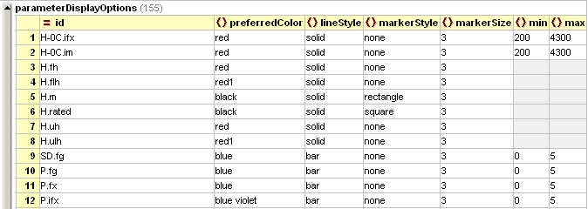
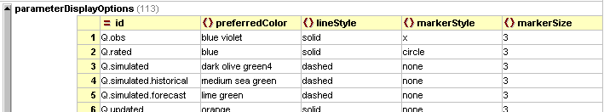
Parameters – time series display configuration
Set default plot attributes per parameter in TimeSeriesDisplayConfig.xml

Slide 16
Exercise
Exercise 3: Parameter properties
Change some attributes of lines plotted for parameters
Add minimum and maximum scaling
Change display precision (default = 3 decimals)
Change some parameter line colours

Slide 17
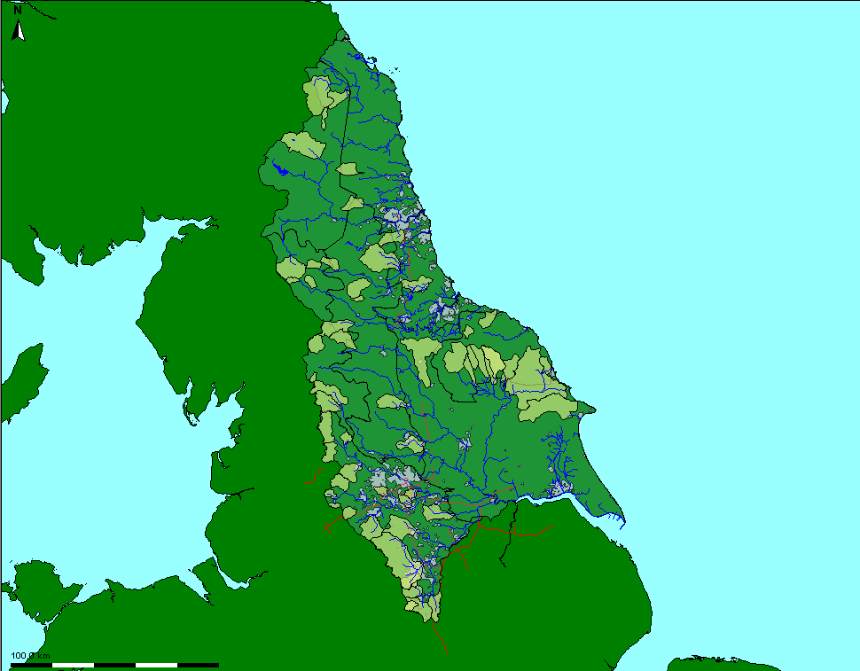
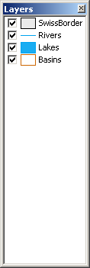
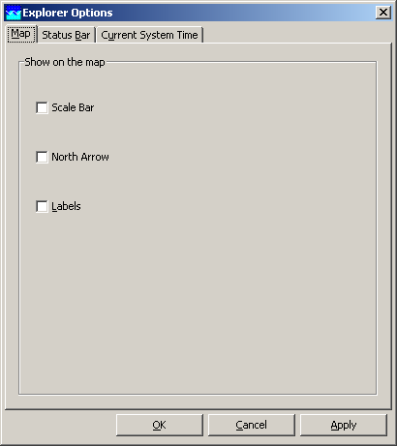

FEWS Maps
FEWS explorer shows map layers & location icons
Map layers:
ArcVIEW, ArcGIS Shape layers
OpenStreetMap, Google earth, Virtual earth
ESRI ASCII grids/images
TIF images
Located in “\MapLayerFiles” or the database
Configuration: “Explorer.xml” (\SystemConfigFiles)
Map layers can be toggled on and off
Scale bar etc. can be switched off via menu

Slide 18
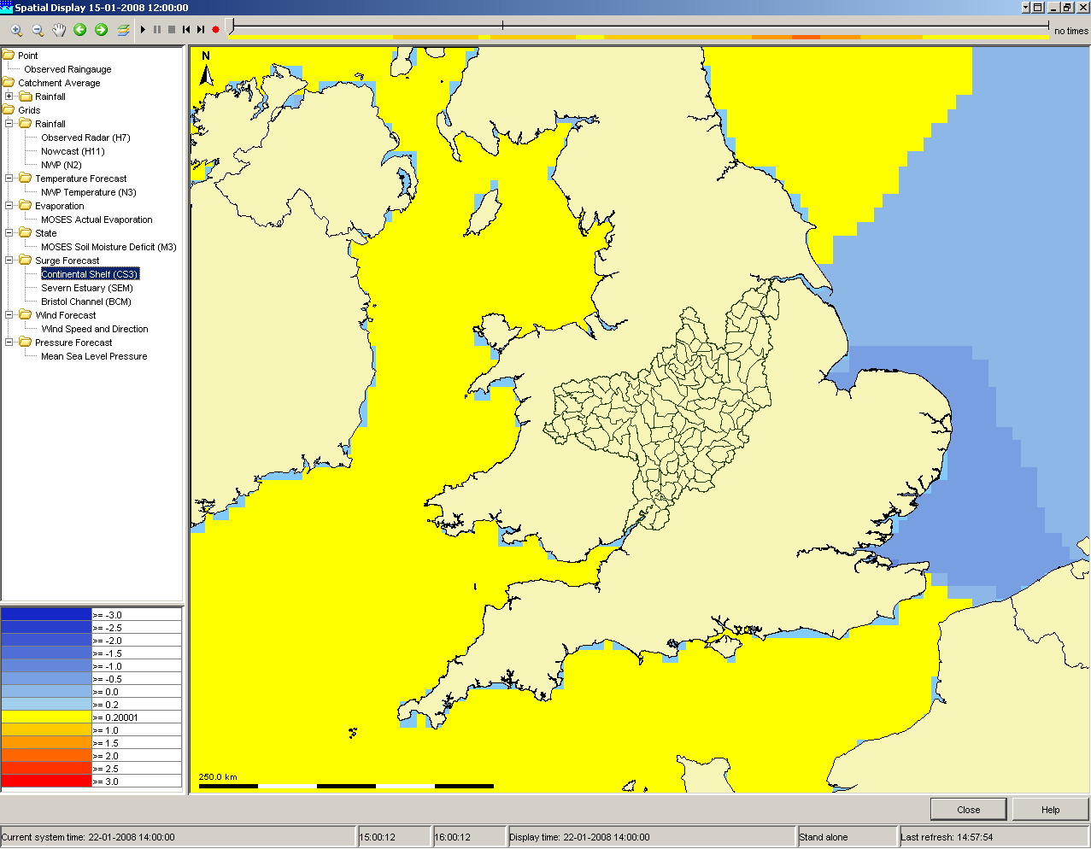
FEWS Map Layers
Other FEWS component
with map layers:
Spatial Display

Slide 19
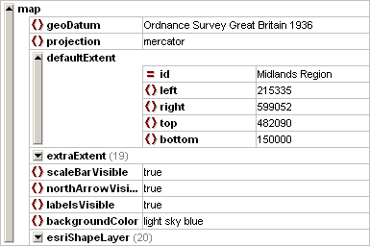
FEWS Maps – Configuration
Geodatum
Projection
Default view extent
Extra extents
Default options
Options to add shapefiles
Options to add grids
Switch to visible

Slide 20
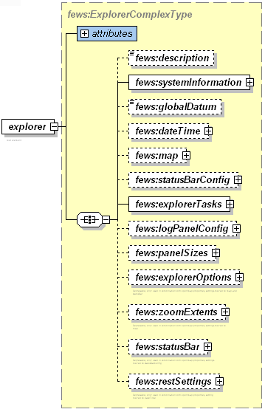
FEWS Explorer
FEWS Explorer is the main GUI
Includes many configuration elements
Configured through the “Explorer” XML file

Slide 21
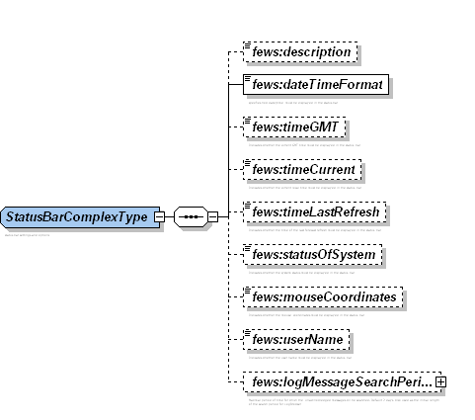
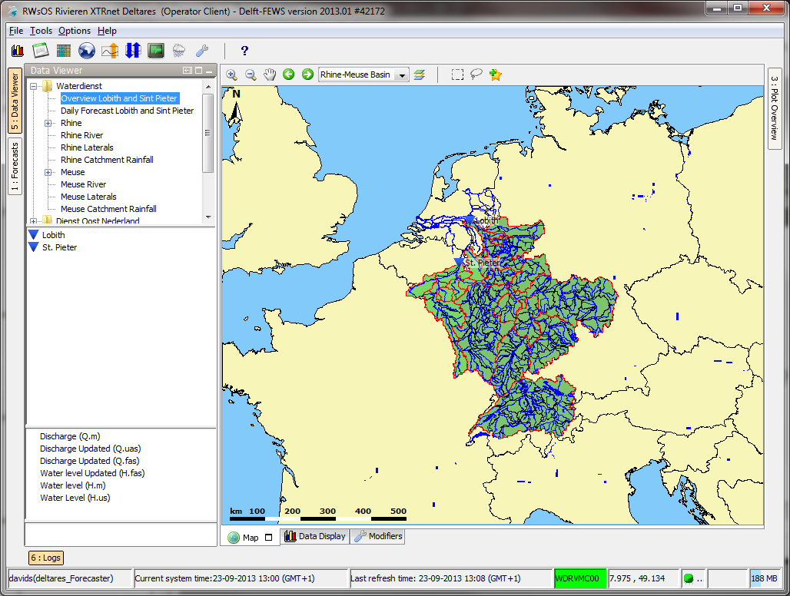
FEWS Explorer – explorer options
Elements that are by default visible
in the status bar when the system is started

Slide 22
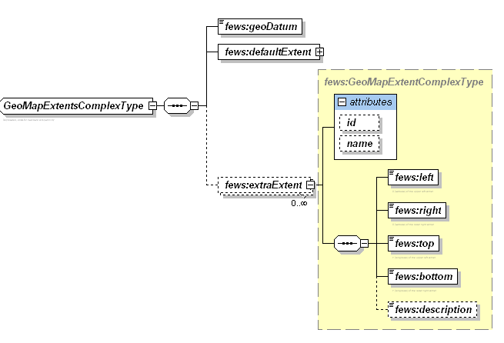
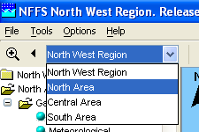

FEWS Explorer – zoom extents
Pre-configured zoom levels that can be selected from FEWS explorer

Slide 23

FEWS Explorer – tasks
Tasks that can be carried out from the explorer
Text
Icons

Slide 24
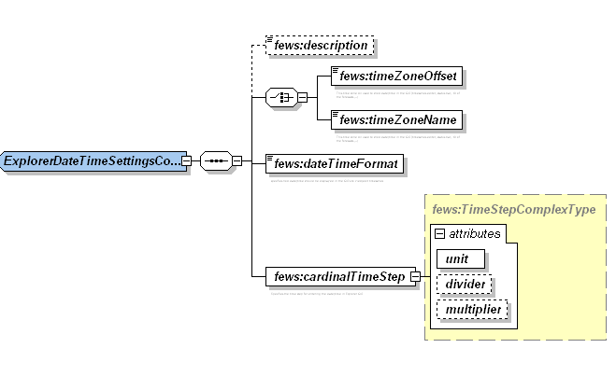
FEWS Explorer – additional settings
Configuration of:
display date time format
time zone
geodatum
cardinal timestep
log panel etc.

Slide 25
Exercise
Exercise 4: FEWS Explorer Elements
Change explorer visible items on start up
Add predefined zoom level

Slide 26
FEWS Static Configurations - Profiles
Profile time series are one dimensional time series
A location is required in the locations XML file
Branches configuration file contains the time series

Slide 27
FEWS Static Configurations - Grids
Grid time series are two dimensional time series
A grid location is required in the locations XML file
Grids configuration file defines the grid
The spatial display file is used to configure the display of grids.

